Slide 1

Global EV Sales - Dashboard
Batch no. 484
D Veerabhadra Reddy

Slide 2
About Me
B-Tech, Computer Science Engineering
In today’s digital world, data is everywhere, and organizations rely on it to make smart decisions. Learning Data Analytics helps us turn raw data into meaningful insights.
LinkedIn: D Veerabhadra Reddy | LinkedIn
GitHub: veerabhadra212

Slide 3
Agenda
Business Problem
Problem Statement
Objective
Dashboard
Conclusion
Recommendation
Thank you

Slide 4
Business Problem
The rapid global transition to sustainable energy has generated a massive influx of fragmented data, making it difficult to accurately track EV market penetration across different regions.
Industry stakeholders struggle to align manufacturing pipelines and supply chains because they lack clear visibility into shifting consumer preferences across different vehicle categories and transport modes.
Without unified analytical insights, planning for critical infrastructure—such as power grid capacity and charging station networks—remains inefficient and reactive, potentially causing bottlenecks in adoption

Slide 5
Problem Statement
Raw EV data is scattered across multiple dimensions (powertrains, regions, years) and mixed units (GWh, vehicle counts, percentages), making standard reporting highly prone to aggregation errors.
There is a lack of a centralized, interactive tool that allows decision-makers to seamlessly filter and compare historical performance against future market projections.
Stakeholders currently spend too much time on manual data wrangling rather than analyzing the key drivers of adoption, such as the impact on electricity demand and oil displacement.

Slide 6
Objective
Architect a dynamic Power BI dashboard utilizing robust data modeling and explicit DAX measures to accurately process, separate, and visualize mixed-unit parameters.
Deliver an interactive visual narrative that empowers users to drill down into year-over-year growth rates, regional dominance, and the shift between specific powertrains (e.g., BEV vs. PHEV).
Transform raw categorical data into actionable insights, enabling stakeholders to optimize their strategic planning and infrastructure investments for both passenger and commercial EV markets.

Slide 7
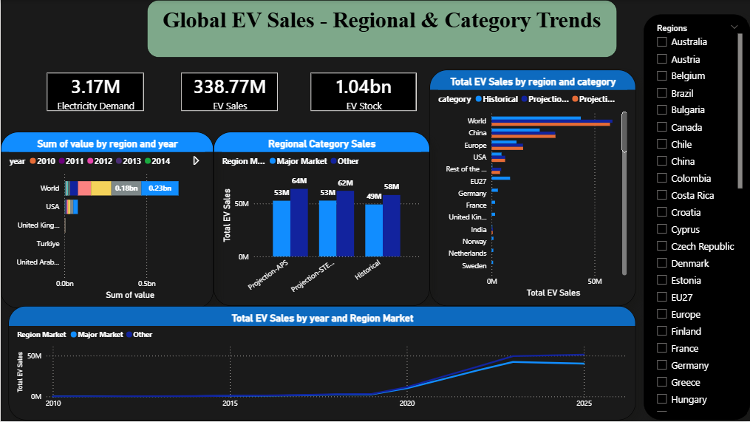
Global EV Sales - Regional & Category Trends

Slide 8
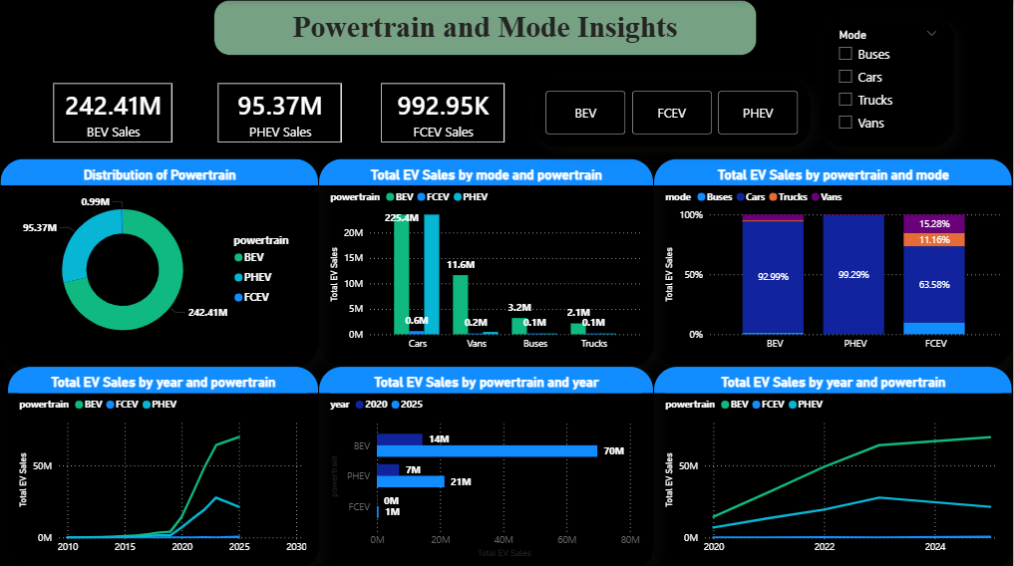
Powertrain & Mode Insights

Slide 9
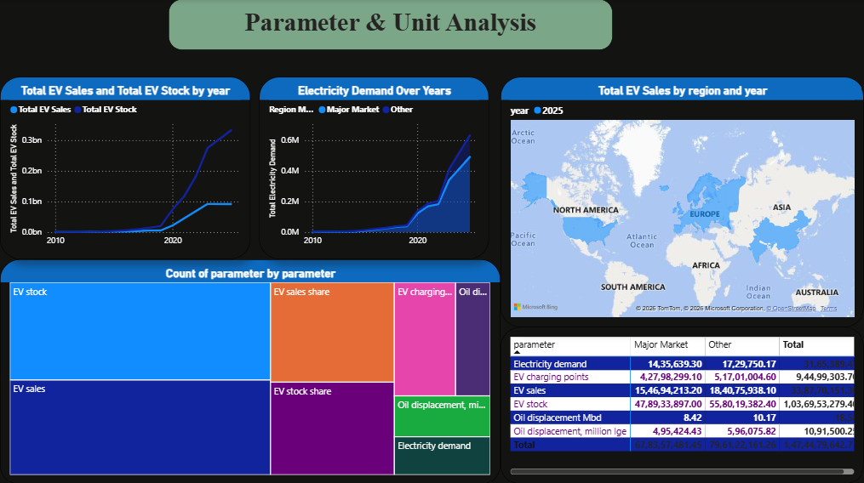
Parameter & Unit Analysis

Slide 10
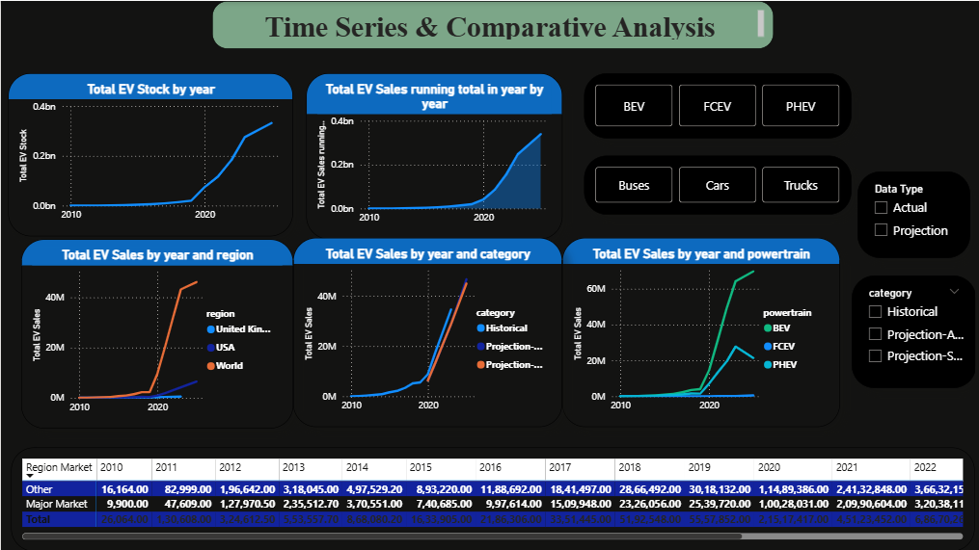
Time Series & Comparative Analysis

Slide 11
Conclusion
Successful Data Synthesis: This project successfully transformed a highly fragmented and complex global dataset into a unified, interactive analytical model, clearly visualizing the exponential growth and trajectory of the EV market from 2010 to 2025.
Clear Market Indicators: The dashboard effectively isolated key market drivers, demonstrating the overwhelming consumer preference for Battery Electric Vehicles (BEVs) in the passenger sector and highlighting the specific regions leading the global transition.
Actionable Infrastructure Insights: By correlating vehicle stock with electricity demand and charging point rollouts, the analysis proved that data-driven visualization is a critical tool for stakeholders needing to align manufacturing output with real-world grid capacity.

Slide 12
Recommendations
Automated Data Pipelines: Transition the dashboard from a static CSV source to an automated ETL pipeline that connects directly to global energy APIs, ensuring the report acts as a live, real-time monitoring tool for decision-makers.
Advanced Predictive Forecasting: Leverage the dataset's future projection scenarios (STEPS and APS) alongside advanced forecasting models to predict precise infrastructure bottlenecks and sales saturation points leading up to 2030 and 2025.

Slide 13


Slide 14

THANK YOU

